Slide 1
BESS – The Business, Economics and Social Studies Programme (TR081)
School of Business, School of Social Sciences and Philosophy
Dr Michael Wycherley
  Director of BESS
    05/12/15

Slide 2
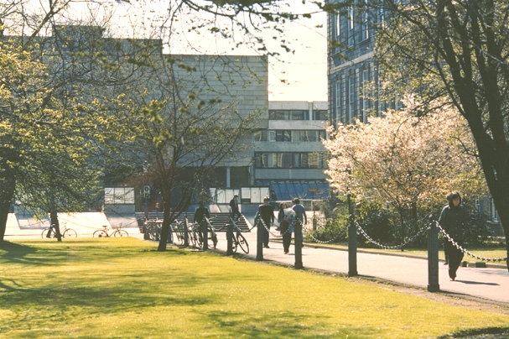

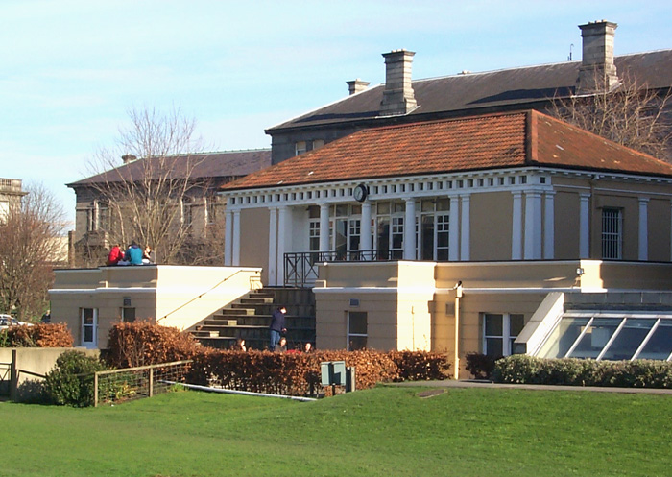
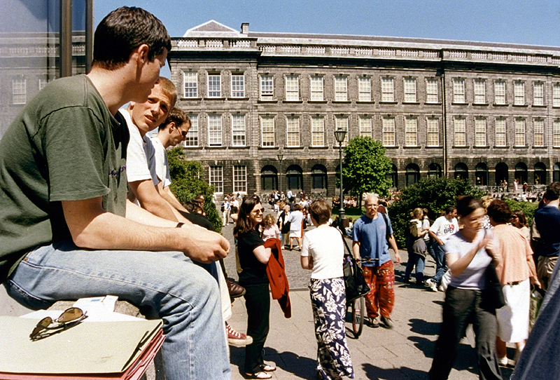
Trinity College… Founded in 1592
A University of Global Consequence
Notes:
The leading Irish research university
Global recognition
Ranked 1st in Ireland and 129th in the World
A community of Scholars
Nobel prize winners
Beckett, Shaw, Walton
For the purpose of compiling the rankings, 5,100 academics from around the world were surveyed concerning the research quality of the university and their views accounted for 40% of the score. In addition, 1,480 international employers in a recruiter review were surveyed concerning their views on graduate employability which accounted for 10%. The other half of the marks was made up of teaching quality which was measured by staff: student ratio (20%), a further 20% was allocated to research quality which was gauged by the university’s citations of major papers. The international outlook was also measured by international faculty staff (5%) and international students (5%). Trinity College scored highly in all of these categories.

Slide 3
What is BESS?
Business
Economics
Political Science
Sociology
Notes:
Gain an understanding of the role of management and organisation in society and knowledge of:
marketing, finance, accounting, entrepreneurship, strategy, human resources, innovation, operations, information systems and many more.
The scientific study of politics, the exercise of power and the workings of democratic political institutions
Only university degree where students can combine the study of Business, Economics, Political Science and Sociology

Slide 4



Business
Gain an understanding of the role of management and organisation in society and knowledge of:
  marketing, finance, accounting, entrepreneurship, strategy, human resources, innovation, operations, information systems and many more.

Slide 5


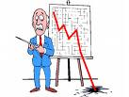
Economics
Develops the concepts and tools to understand:
  How to limit / prevent unemployment
  How to regulate financial markets
  How to control the market power of large firms
  How best to address climate change
  How to help poorer countries grow and develop

Slide 6
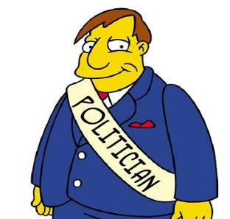


Political Science
The scientific study of politics, the exercise of power and the workings of democratic political institutions
Students will learn about
  How democracy works
  How people vote
  How political parties compete
  How European integration works
  The values behind political ideologies

Slide 7
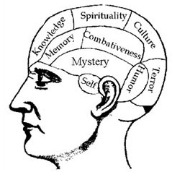

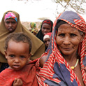
Sociology
Understand phenomena such as
  Social change and how it affects your own life and that of others
  Shared practices of behaviour
  Social movements like fair trade or feminism
  Inequality at global and local levels
  The nature and meaning of work

Slide 8
Degree Options in BESS
Business
Economics
Political Science
Sociology
Business & Economics
Political Science & Sociology
Economics & Sociology
Business & Political Science
Sociology & Business
Economics & Political Science
Single Honors
Joint Honors
Notes:
Explore the world of business and management
Study subjects including marketing, management, human resources, innovation, strategy, entrepreneurship, accountancy and many more.
Flexible programme with 10 different degree options across these four subjects

Slide 9

What will I study?
  Start with a grounding in all four subjects
  Then continue with those that interest you
  In the last two years choose the modules that interest you in one or two subjects
  Plus there’s the opportunity to study abroad in third year

Slide 10
Junior Freshman – 1st Year
  Introduction to Organisation and Management
  Introduction to Economics
  Introduction to Political Science
  Introduction to Sociology
  Mathematics and Statistics
  Another module of your choice (Language, Law or Social Policy)

Slide 11
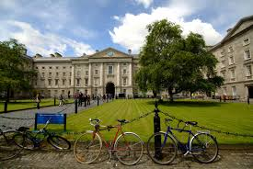
Senior Freshman – 2nd Year
  Ensures you have the fundamental skills in the one or two subjects you choose.
  Option to continue with Language module
  Broad Curriculum module option
  Foundation Scholarship

Slide 12
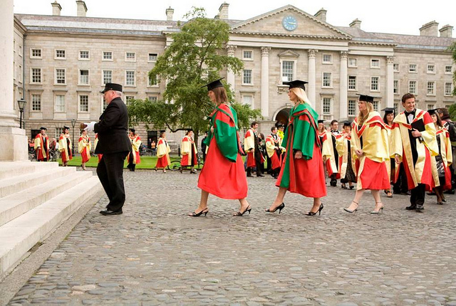
Junior & Senior Sophister, 3rd & 4th Year
  Specialise in one (Single honor) or two (Joint honors) subjects
  Option to undertake an undergraduate dissertation in the final year
  Ordinary (3rd Year) or Honor (4th Year) degrees
  Careers or continuing education information sessions provided

Slide 13

BESS Study Abroad Programme
Languages options (French, German, Polish, Russian and Spanish) are integrated into the BESS programme
Students can choose to study abroad during their third year:
  Europe
  Asia
  USA
  Canada

Slide 14

Your future
BESS Graduates are highly sought after by leading employers
  Financial Services and Accountancy
  Academia
  Economic and Political Journalism
  Public Services
  International Business
  Management Consulting
  Entrepreneurial Ventures
  Professional Training

Slide 15

Why choose BESS?
  Study at Ireland’s No.1 University in Ireland’s No.1 departments in their fields
  Look at the world around us in a variety of ways
  Combines flexibility, breadth and depth
  Student Centred Programme
  Exceptional Calibre of Students
  Strong reputation
  Highly Sought After Graduates

Slide 16
Applying for BESS
CAO Points 2010 - 2015
2011
480*
2012
490*
2013
495*
2014
495
2015
510
Notes:
BESS Quota is 236

Slide 17

The Trinity Experience
Many societies organised by and for students
Some BESS relevant Student Societies
  DUBES – Dublin University Business & Economic Society
  Political Science Society
  Social Studies Society
  AIESEC
  Foresight
  Enterprise Trinity
  Upstart
Something missing? Organise it yourself!
Notes:
Foresight: business school: forum to meet businessmen
Enterprise: supports start ups
Upstart: entrepreneurs

Slide 18
Other programme options at TCD linked to BESS subjects
  PPES: Philosophy, Political Science, Economics & Sociology
  Business & Language / Law / Computer Science
  TSM: Economics & Sociology
  Political Science & History / Geography / Law
  Sociology and Social Policy

Slide 19

To find out more about BESS
  Information stands for BESS, Business, Economics, Political Science and Sociology are located in the Examination Hall (Front Square)
  Visit our website and FAQ page at www.tcd.ie/bess
  Send us an email to bess@tcd.ie

Slide 20
BESS Programme
And Finally….
We hope you enjoy Open Day 2015 and choose BESS as your first preference CAO choice
Dr Michael Wycherley
Director of BESS

Slide 21
Thank You

